Slide 1

COVID-19
ANALYSIS PROJECT

Slide 2

PART 1: OVERVIEW
1.1. PROJECT OBJECTIVE
1.2. DATA MODEL
1.3. REPORT OVERVIEW

Slide 3


1.1. PROJECT OBJECTIVE
Provide a thorough analysis of the global impact of
Covid-19, focusing on three aspects:
Infection trends
Fatality rates
Vaccination efforts
Highlight trends and variations in the number of cases and deaths
While examine the effectiveness of vaccination programs

Slide 4
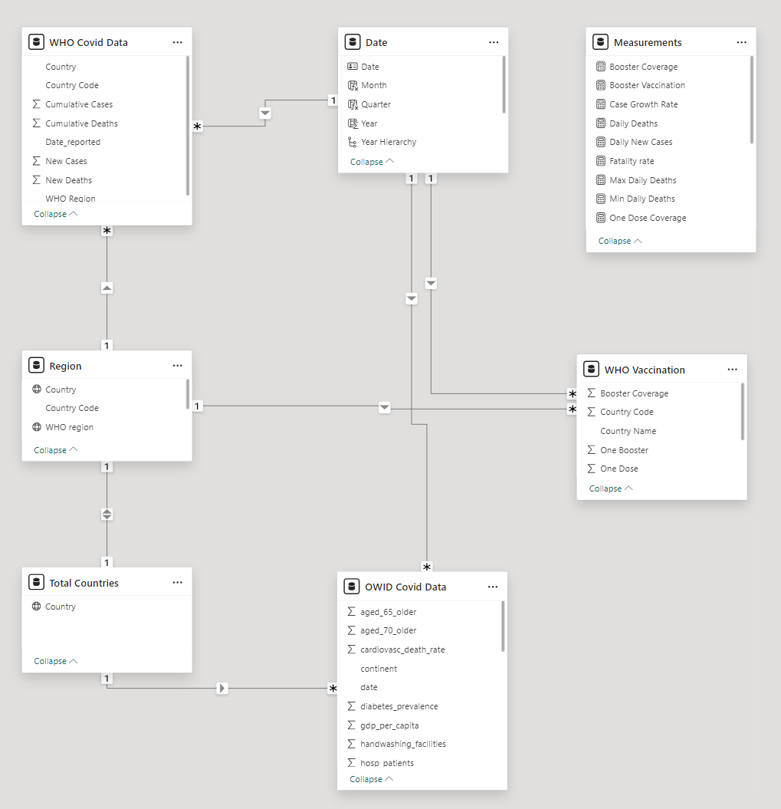
1.2. DATA MODEL
3 Fact Tables:
WHO Covid Data: downloaded from WHO website
WHO Covid Vaccination: crawled from WHO website
OWID Covid Data: provided by Datapot
3 Dim Tables: extracted from Fact Tables
1 Measurement Table

Slide 5
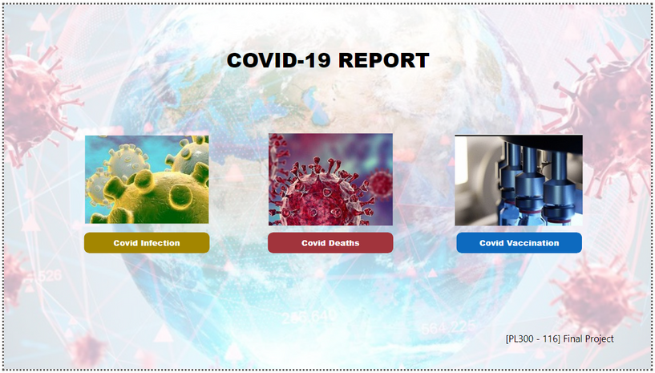
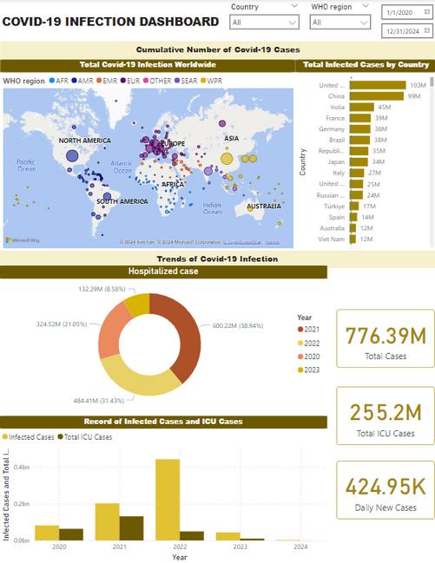
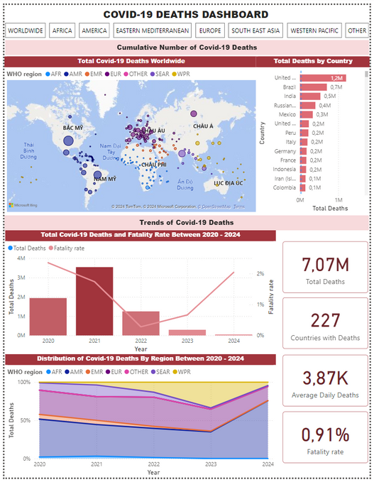
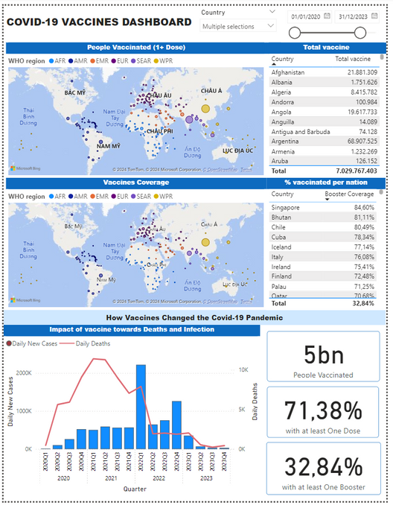
1.3. REPORT OVERVIEW

Slide 6

PART 2:
ANALYSIS
2.1. COVID INFECTION
2.2. COVID FATALITY
2.3. COVID VACCINATION

Slide 7

2.1. COVID INFECTION

Slide 8
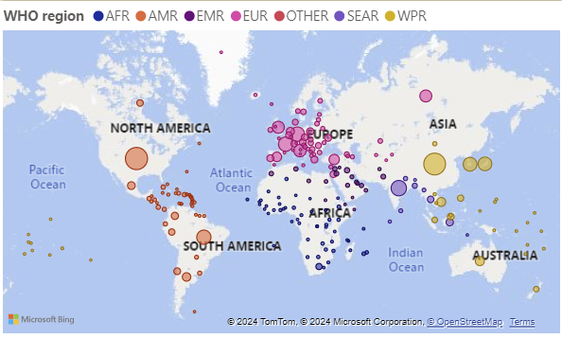
Covid - 19: the infectious disease
COVID-19 is an infectious disease caused by the SARS-CoV-2 virus
First detected in late 2019 in Wuhan city, China

Slide 9
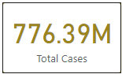
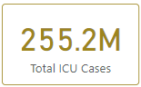
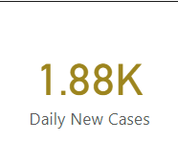
Infection numbers of a global pandemic
The total number of cases worldwide is 776.39 million people.
Every day about 1.88 thousand people get infected
ICU is about 255 million people

Slide 10
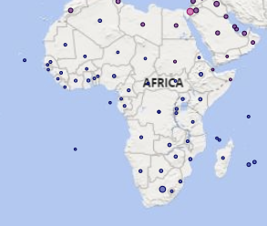
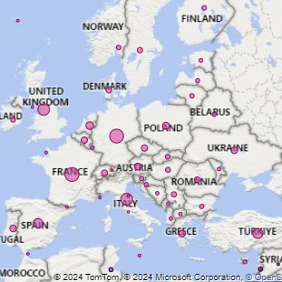
Regions with significant cases (Africa, Europe)
Africa also has many cases.
Slow development in medicine and technology
Europe is an area with a lot of international movement.
Countries like the UK, Italy, France and Germany have struggled to vaccinate against COVID-19.

Slide 11
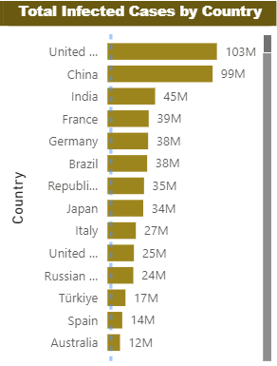
Regions with significant cases (America)
The US is the country with the highest Covid infection rate in the world.
In the United States, the health care system is operated at both the state and federal levels.
The United States has a high rate of people with underlying medical conditions
Political and cultural factors.
China is the second highest country.

Slide 12
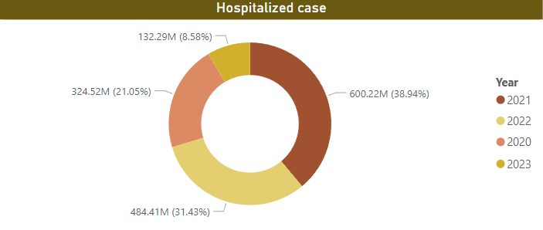
Severe Cases
The number of patients hospitalized with Covid in 2020 was 324 million.
This number peaked in 2021.
In 2022, due to global quarantine, the number of hospitalized patients also decreased significantly.
Numbers rose again in 2023.

Slide 13
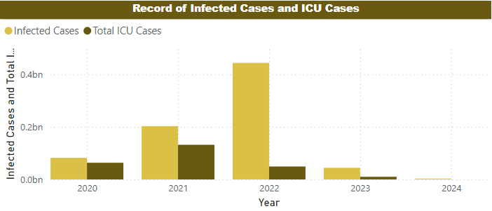
Severe Cases
The ratio of Covid-infected patients to patients in intensive care (ICU) is quite different.
Numbers peaked in 2022.
This number was significantly reduced in later years due to the advent of vaccines.

Slide 14

2.2. COVID FATALITY

Slide 15
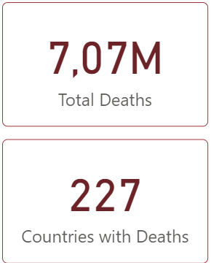
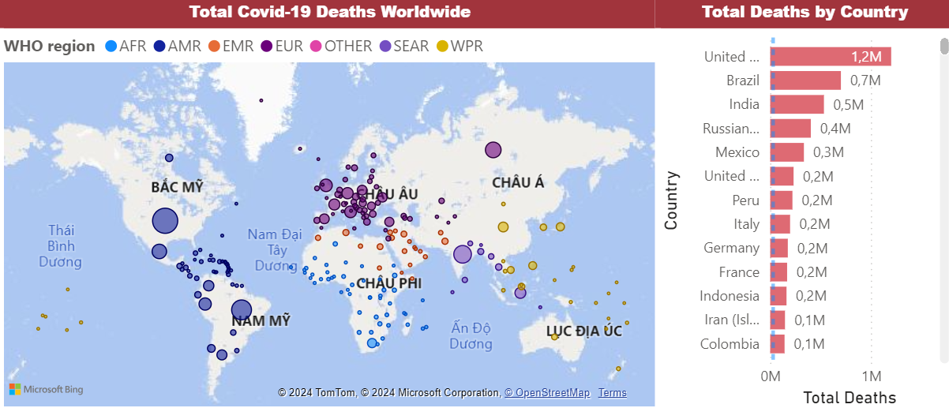
The distribution of Covid deaths closely aligns with that of infection
Most deaths happened in American and European countries that had more infected cases
The U.S. tops the list with over 1.2 million Covid-19 deaths, followed by Brazil, India, Russia, and others

Slide 16
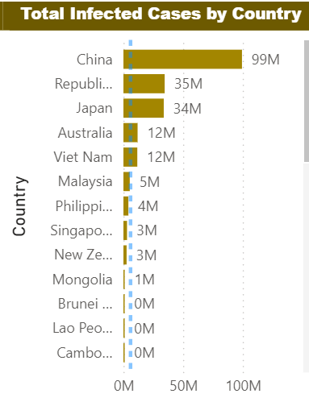
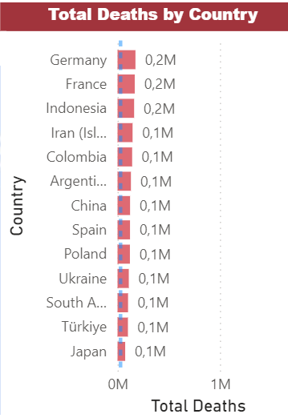
However, more cases doesn’t necessarily mean more deaths
CHINA
China ranked second worldwide in the number of cases with 99 million infected cases
But had only 0.1 million deaths due to strict quarantine policies

Slide 17
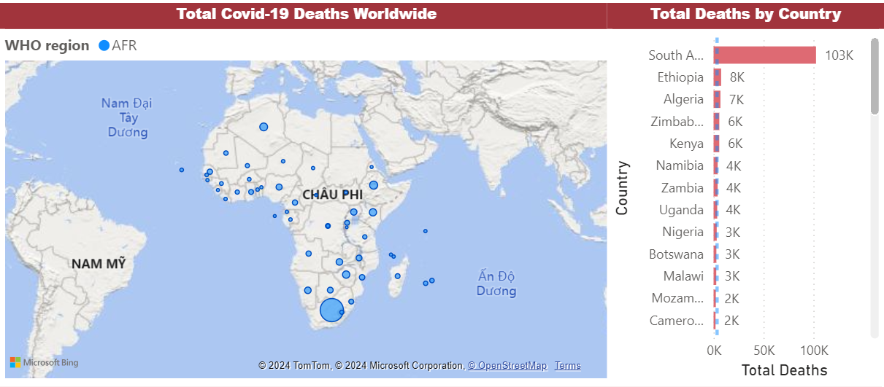
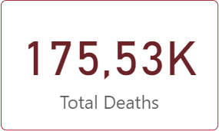
However, more cases doesn’t necessarily mean more deaths
AFRICA
175k deaths all over Africa
~2,5% of total world’s deaths
Although Africa is among the regions with the highest number of cases, it has the lowest death rate due to:
A young, healthy population
Hot weather that is unfavorable for the Covid virus.

Slide 18

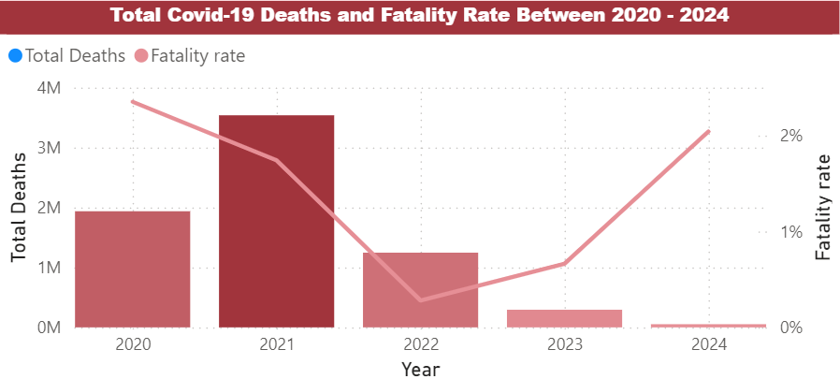
Overall trend of Covid Deaths
Dataset updated to March, 2024
The highest records occurred in 2020 and 2021
Pandemic was at its peak
Vaccines were not widely available
In 2023 and 2024, despite fewer cases, the fatality rate increased
-> People infected often had weak immunity or underlying conditions

Slide 19

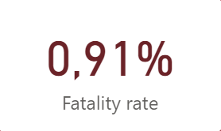
Covid fatality rate is not high
Over 7 million deaths in 227 countries
-> Unprecedented pandemic
Overall, fatality rate of Covid-19 is 0,91%
-> Relatively low compared to other global pandemics like the Spanish Flu, Ebola, and SARS.

Slide 20
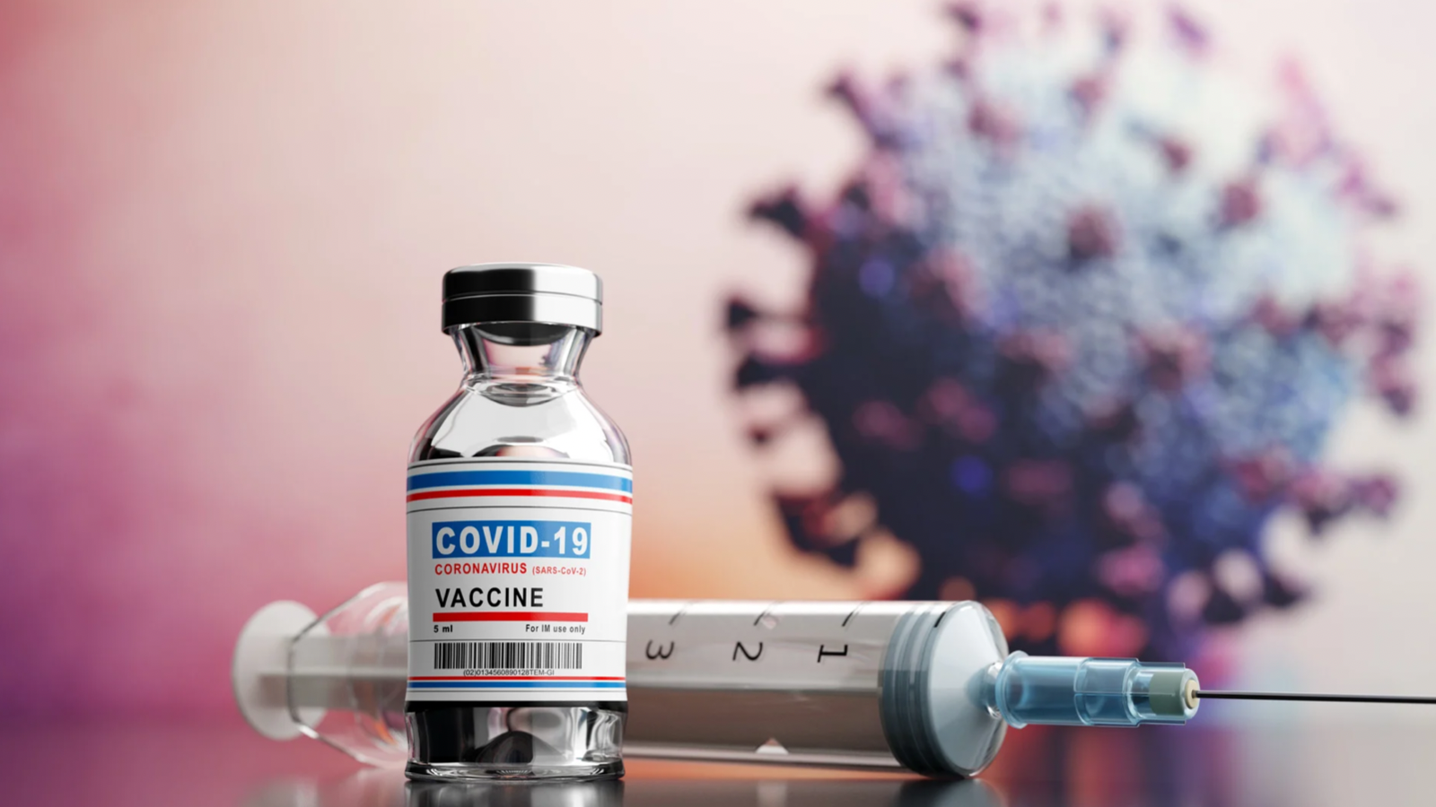
2.3. COVID VACCINATION

Slide 21

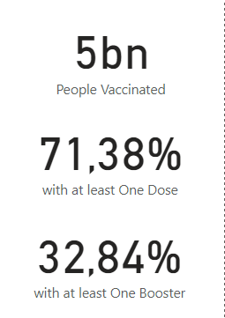
Covid vaccination status
5 billion of people are vaccinated
71.38% world population received 1+ dose
Half of them received at least one additional dose
Try this background for online class.
*Please delete this section before downloading.

Slide 22
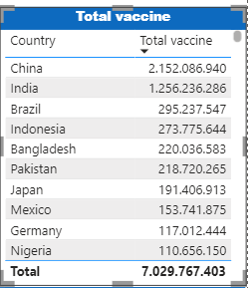
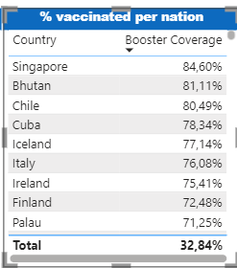
Covid vaccination status
China and India are the countries with most vaccines administered, corresponding to their large populations.
Countries with highest vaccine coverage typically reach 80% booster coverage while the world’s average is 32%

Slide 23

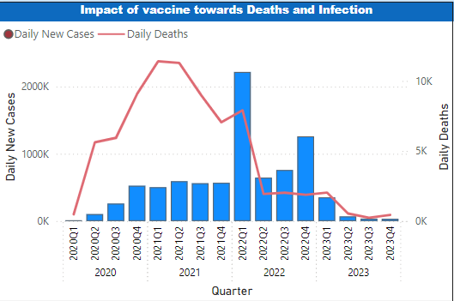
Impact of vaccine
The Covid-19 vaccine has proven to be highly effective
Reducing fatality rate by half
Reducing the severity of the disease
Slowing down infection rate.

Slide 24






THANK YOU
For Your Attention

